Slide 1
Lecture 1
Introduction to Computer Networks

Slide 2
References
Data and Computer Communications ⎯ William Stalling, Prentice Hall, 5th Edition, 1997.
Data Communication and Networking ⎯ Forouzan B.A., McGraw-Hill.
Computer Networking ⎯ Andrew S. Tanenbaum.

Slide 3
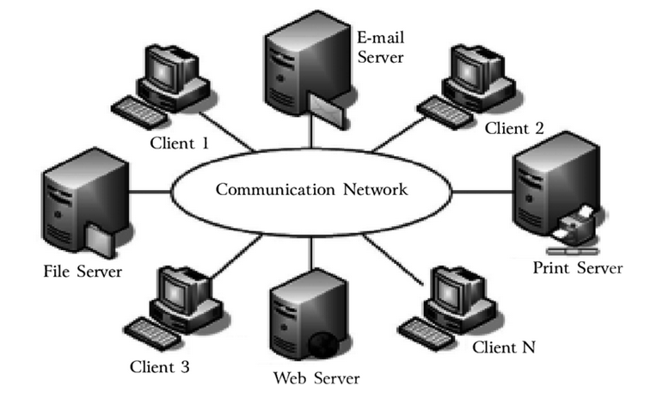
Introduction
A system of interconnected computers and computerized peripherals such as printers is called computer network.

Slide 4
Classification of Computer Networks
Computer networks are classified based on various factors. They includes
Geographical span
Inter-connectivity
Administration
Architecture

Slide 5
Geographical span
Geographically a network can be seen in one of the following categories.
It may be spanned across your table, among Bluetooth enabled devices,. Ranging not more than few meters.
It may be spanned across a whole building, including intermediate devices to connect all floors.
It may be spanned across a whole city.
It may be spanned across multiple cities or provinces.
It may be one network covering whole world.

Slide 6
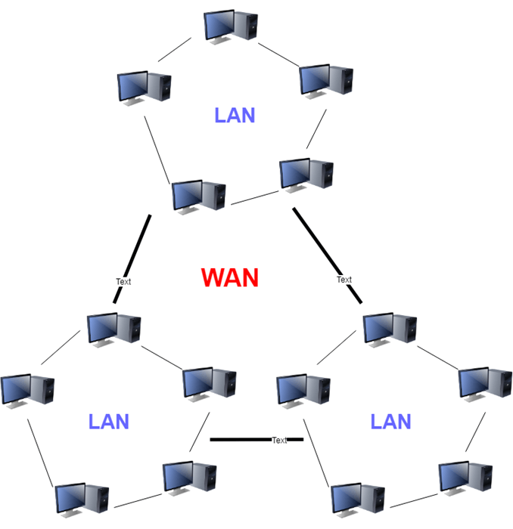
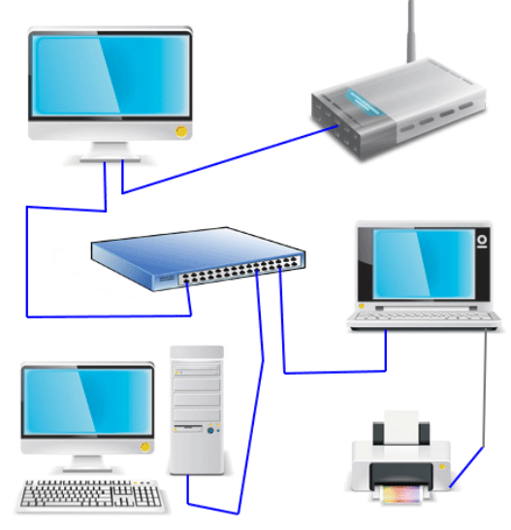
Geographical span

Slide 7
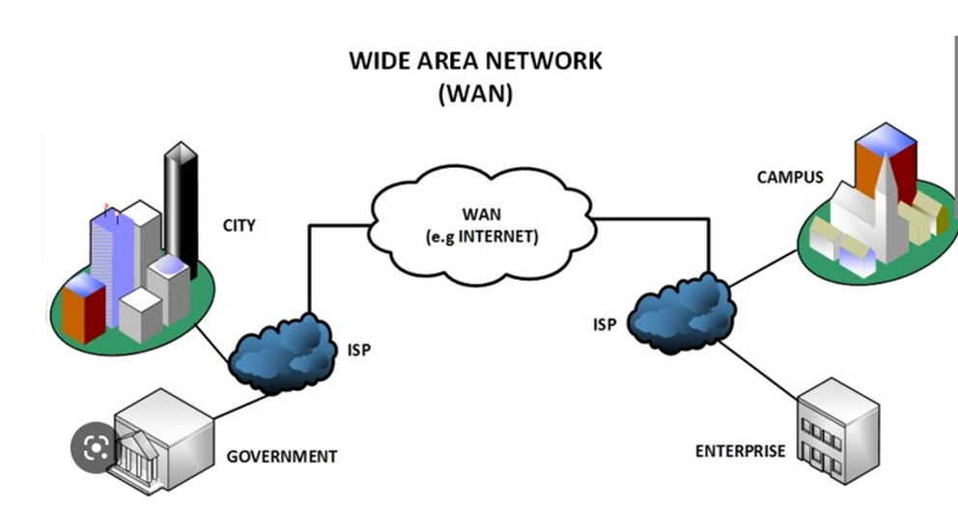
Geographical span

Slide 8
Inter-Connectivity
Components of a network can be connected to each other differently in some fashion. By connectedness we mean either logically, physically, or both ways.
Every single device can be connected to every other device on network, making the network mesh.
All devices can be connected to a single medium but geographically disconnected (??)
Each device is connected to its left and right peers only, creating linear structure.

Slide 9
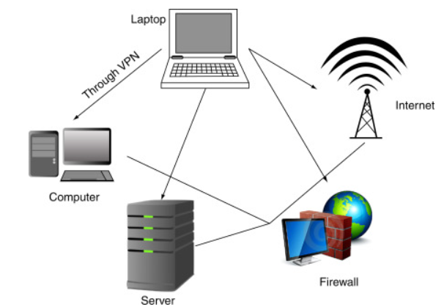
Inter-Connectivity
All devices connected together with a single device, creating star (?) like structure.
All devices connected arbitrarily using all previous ways to connect each other, resulting in a hybrid structure

Slide 10
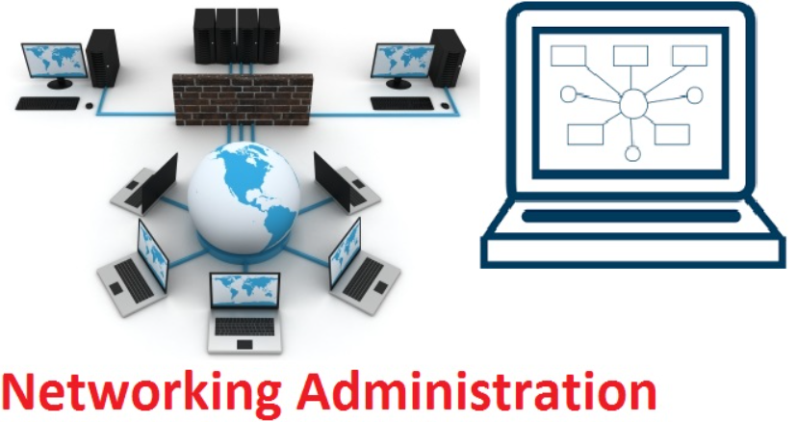
Administration
From an administrator’s point of view, a network can be private network which belongs a single autonomous system and cannot be accessed outside its physical or logical domain. A network can be public which is accessed by all.

Slide 11
There are 5 very important things that need to be known are as follows:
Have an Updated Technology
Should be Skilled
Career opportunity
Project Management
Salary Package

Slide 12
Network Architecture
Computer networks can be discriminated into various types such as Client-Server, peer-to-peer or hybrid, depending upon its architecture. Have an Updated Technology.
There can be one or more systems acting as Server. Other being Client, requests the Server to serve requests. Server takes and processes request on behalf of Clients.
Two systems can be connected Point-to-Point, or in back-to-back fashion. They both reside at the same level and called peers.
There can be hybrid network which involves network architecture of both types.

Slide 13
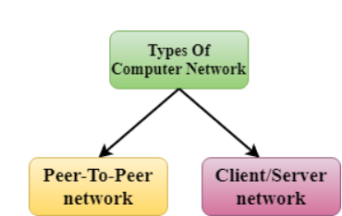
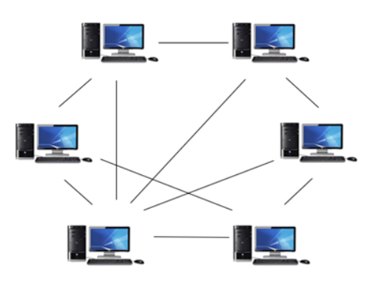
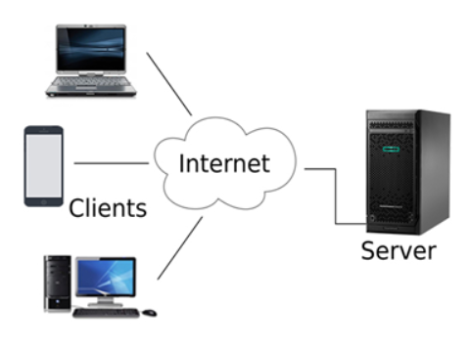
Network Architecture
There can be hybrid network which involves network architecture of both types.

Slide 14
Network Applications
Computer systems and peripherals are connected to form a network. They provide numerous advantages: There can be hybrid network which involves network architecture of both types.
Resource sharing such as printers and storage devices
Exchange of information by means of e-Mails and FTP
Information sharing by using Web or Internet
Interaction with other users using dynamic web pages
IP phones
Video conferences
Parallel computing
Instant messaging

Slide 15
Network Applications
Generally, networks are distinguished based on their geographical span. A network can be as small as distance between your mobile phone and its Bluetooth headphone and as large as the internet itself, covering the whole geographical world.

Slide 16
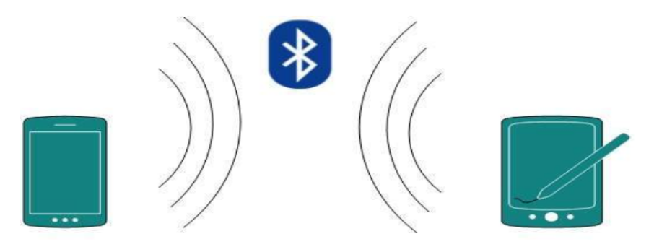
Personal Area Network
Personal Area Network (PAN) is smallest network which is very personal to a user. This may include Bluetooth enabled devices or infra-red enabled devices. PAN has connectivity range up to 10 meters. PAN may include wireless computer keyboard and mouse, Bluetooth enabled headphones, wireless printers and TV remotes.
For example, Piconet is Bluetooth-enabled Personal Area Network which may contain up to 8 devices connected together in a master-slave fashion.

Slide 17
Local Area Network
A computer network spanned inside a building and operated under single administrative system is generally termed as Local Area Network (LAN). Usually, A covers an organization 'offices, schools, colleges or universities. Number of systems connected in LAN may vary from as least as two to as much as 16 million.
LAN provides a useful way of sharing the resources between end users. The resources such as printers, file servers, scanners, and internet are easily sharable among computers.

Slide 18
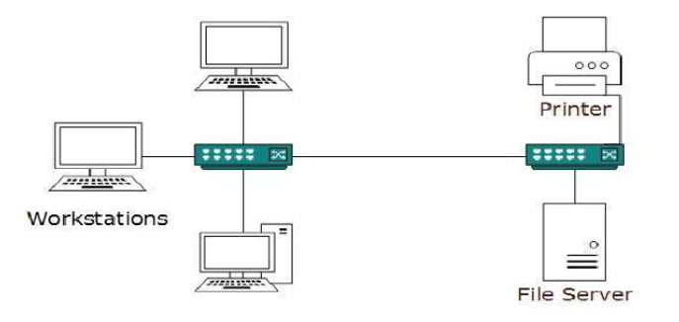
Local Area Network

Slide 19
Local Area Network
LANs are composed of inexpensive networking and routing equipment. It may contains local servers serving file storage and other locally shared applications. It mostly operates on private IP addresses and does not involve heavy routing. LAN works under its own local domain and controlled centrally.
LAN uses either Ethernet or Token-ring technology. Ethernet is most widely employed LAN technology and uses Star topology, while Token-ring is rarely seen.
LAN can be wired, wireless, or in both forms at once.

Slide 20
Metropolitan Area Network
The Metropolitan Area Network (MAN) generally expands throughout a city such as cable TV network. It can be in the form of Ethernet, Token-ring, ATM, or Fiber Distributed Data Interface (FDDI).
Metro Ethernet is a service which is provided by ISPs. This service enables its users to expand their Local Area Networks. For example, MAN can help an organization to connect all of its offices in a city.

Slide 21
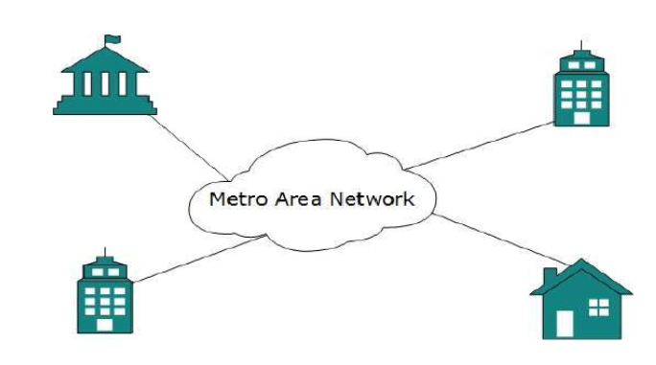
Metropolitan Area Network
Backbone of MAN is high-capacity and high-speed fiber optics. MAN works in between Local Area Network and Wide Area Network. MAN provides uplink for LANs to WANs or internet.

Slide 22
Wide Area Area Network
As the name suggests, the Wide Area Network (WAN) covers a wide area which may span across provinces and even a whole country. Generally, telecommunication networks are Wide Area Network. These networks provide connectivity to MANs and LANs. Since they are equipped with very high speed backbone, WANs use very expensive network equipment.

Slide 23
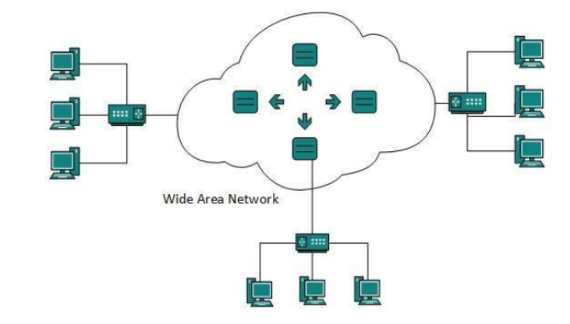
Wide Area Area Network
WAN may use advanced technologies such as Asynchronous Transfer Mode (ATM), Frame Relay, and Synchronous Optical Network (SONET). WAN may be managed by multiple administrations.

Slide 24
Internetwork
A network of networks is called an internetwork, or simply the internet. It is the largest network in existence on this planet. The internet hugely connects all WANs and it can have connection to LANs and Home networks. Internet uses TCP/IP protocol suite and uses IP as its addressing protocol. Present day, Internet is widely implemented using IPv4.Because of shortage of address spaces, it is gradually migrating from IPv4 to IPv6.

Slide 25
Internetwork
Internet enables its users to share and access enormous amount of information worldwide. It uses WWW, FTP, email services, audio and video streaming etc. At huge level, internet works on Client-Server model.
Internet uses very high speed backbone of fiber optics. To inter-connect various continents, fibers are laid under sea known to us as submarine communication cable.

Slide 26
Internetwork
Internet is widely deployed on World Wide Web services using HTML linked pages and is accessible by client software known as Web Browsers. When a user requests a page using some web browser located on some Web Server anywhere in the world, the Web Server responds with the proper HTML page. The communication delay is very low.

Slide 27
Internetwork
Internet is serving many proposes and is involved in many aspects of life. Some of them are:
Web sites
E-mail
Instant Messaging
Blogging
Social Media
Marketing
Networking
Resource Sharing
Audio and Video Streaming

Slide 28

Point-to-point
Point-to-point networks contain exactly two hosts such as computer, switches or routers, servers connected back to back using a single piece of cable. Often, the receiving end of one host is connected to sending end of the other and vice-versa.
If the hosts are connected point-to-point logically, then may have multiple intermediate devices. But the end hosts are unaware of underlying network and see each other as if they are connected directly.

Slide 29
Bus Topology
In case of Bus topology, all devices share single communication line or cable. Bus topology may have problem while multiple hosts sending data at the same time. Therefore, Bus topology either uses CSMA/CD technology or recognizes one host as Bus Master to solve the issue. It is one of the simple forms of networking where a failure of a device does not affect the other devices. But failure of the shared communication line can make all other devicesstop functioning.

Slide 30
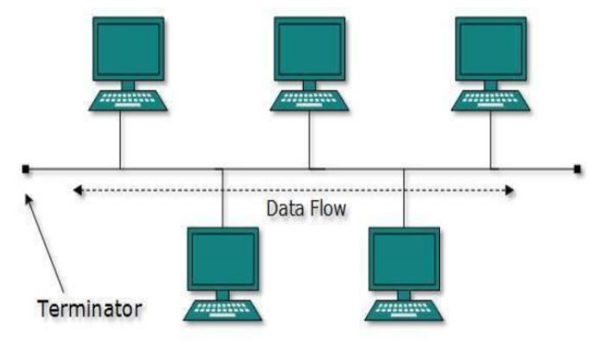
Bus Topology
Both ends of the shared channel have line terminator. The data is sent in only one direction and as soon as it reaches the extreme end, the terminator removes the data from the line.

Slide 31
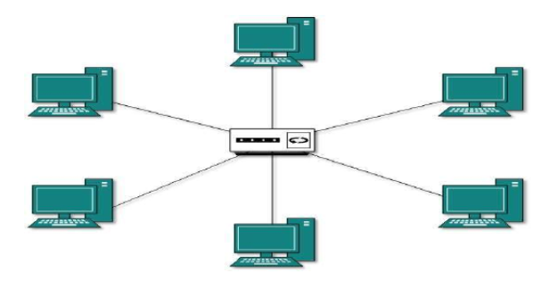
Star Topology
All hosts in Star topology are connected to a central device, known as hub device, using a point-to-point connection. That is, there exists a point to point connection between hosts and hub.

Slide 32
Star Topology
As in Bus topology, hub acts as single point of failure. If hub fails, connectivity of all hosts to all other hosts fails. Every communication between hosts, takes place through only the hub. Star topology is not expensive as to connect one more host, only one cable is required and configuration is simple.

Slide 33
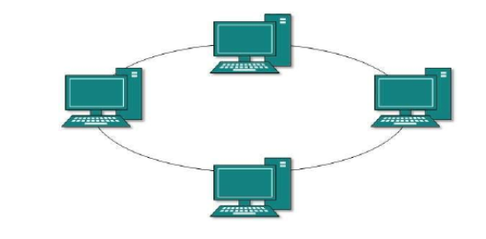
Ring Topology
In ring topology, each host machine connects to exactly two other machines, creating a circular network structure. When one host tries to communicate or send message to a host which is not adjacent to it, the data travels through all intermediate hosts. To connect one more host in the existing structure, the administrator may need only one more extra cable.

Slide 34
Ring Topology
Failure of any host results in failure of the whole ring. Thus, every connection in the ring is a point of failure. There are methods which employ one more backup ring.

Slide 35
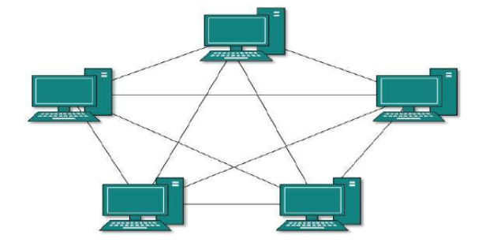
Mesh Topology
In this type of topology, a host is connected to one or multiple hosts. This topology has hosts in point-to-point connection with every other host or may also have hosts which are in point-to-point connection to few hosts only.

Slide 36
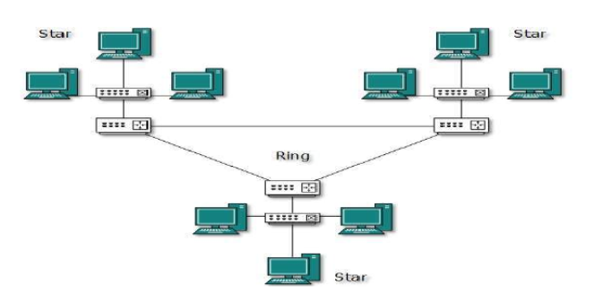
Hybrid Topology
A network structure whose design contains more than one topology is said to be hybrid topology. Hybrid topology inherits merits and demerits of all the incorporating topologies.

Slide 37
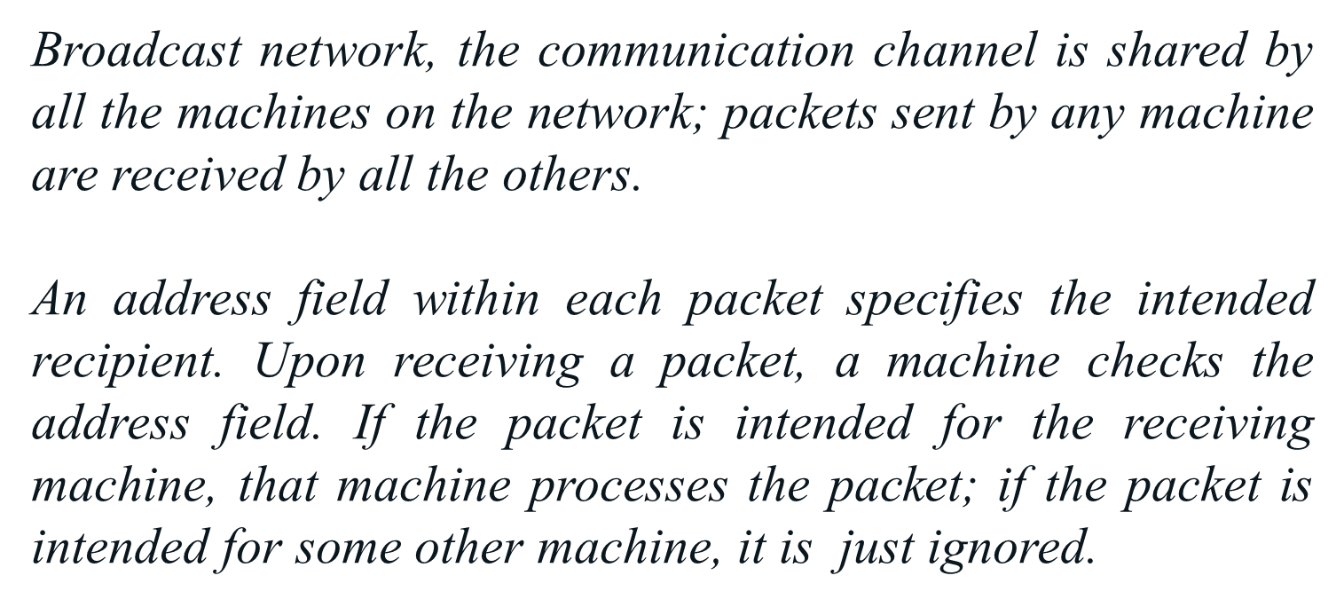

Slide 38
A wireless network is a common example of a broadcast link, with communication shared over a coverage region that depends on the wireless channel and the transmitting machine. Broadcast systems usually also allow the possibility of addressing a packet to all destinations by using a special code in the address field. When a packet with this code is transmitted, it is received and processed by every machine on the network. This mode of operation is called broadcasting.

Slide 39
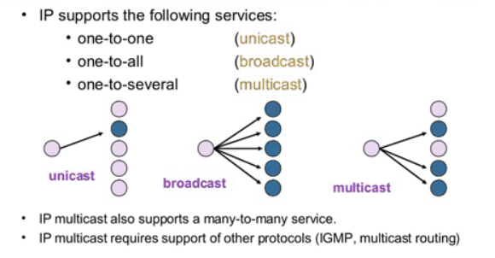

Slide 40
To reduce their design complexity, most networks are organized as a stack of layers or levels, each one built upon the one below it.
The purpose of each layer is to offer certain services to the higher layers while shielding those layers from the details of how the offered services are actually implemented.
When layer of n one machine carries on a conversation with layer n on another machine, the rules and conventions used in this conversation are collectively known as the layer n protocol.
Basically, a protocol is an agreement between the communicating parties on how communication is to proceed.

Slide 41
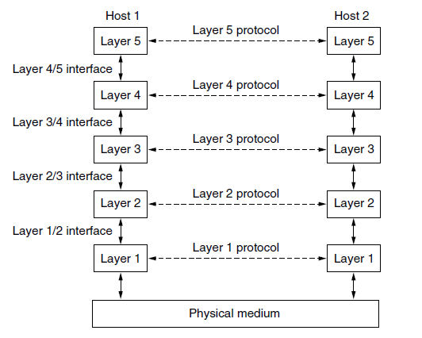
A five-layer network is illustrated in Fig. below. The entities comprising the corresponding layers on different machines are called peers. The peers may be software processes, hardware devices, or even human beings. In other words, it is the peers that communicate by using the protocol to talk to each other.

Slide 43
In reality, no data are directly transferred from layer n on one machine to layer n on another machine. Instead, each layer passes data and control information to the layer immediately below it, until the lowest layer is reached. Below layer 1 is the physical medium through which actual communication occurs.
Between each pair of adjacent layers is an interface. The interface defines which primitive operations and services the lower layer makes available to the upper one

Slide 44
In reality, no data are directly transferred from layer n on one machine to layer n on another machine. Instead, each layer passes data and control information to the layer immediately below it, until the lowest layer is reached. Below layer 1 is the physical medium through which actual communication occurs.

Slide 45
Continue (online)

